Slide 1
Software Engineering _____________________________________________________
Feb 2013

Slide 2
Objectives
To acquire knowledge of Software Engineering
Hands-on experience in Project Management

Slide 3
Course Coverage
Introduction
  Software and Software Engineering
  Software Process
SDLC and Process Models
Requirement Engineering
  Requirement analysis
Use case approach
  Use cases & usage scenarios
  Use cases & functional requirements, Benefits of Use cases
Design concepts

Slide 4
Course Coverage…..
Software implementation and maintenance
Software testing
Software Quality Assurance & Quality Attributes
Configuration management
Project Management
  Scope, Organizing, Planning
  Scheduling, Activity Organization, Milestones, Deliverables
Risk Management
  Risk Identification, Analysis, Monitoring & Control

Slide 5
Reference Books
Software Engineering: A Practitioner’s Approach by Roger S. Pressman
Fundamentals of Software Engineering by Rajib Mall
Brook's paper on Mythical man month Addison-Wesley 1975
Software projects are different, Max Bullock & Wideman

Slide 6
Introduction
What is Software?
  Software is the product that software professionals build and then support over a long term
  It encompasses
    programs that execute within a defined computer size and architecture
    content that is presented as the programs execute.
Software acts with a dual role
  Software product
  Application tool or environment for software product development.

Slide 7
Introduction…..
Features of Computer Application
  Accuracy
  Diligence – repeated activity over time
  Speed
  Storage
Usage of Computers
  Games
  Document generation
  Data Storage
  Send emails
  E-shopping / e-commerce
  Animation, Movies
  Science – space, meteorology
  Accounts – various applications including reservations
  Architecture and Design

Slide 8
Introduction…..
Characteristics of Software
  Software is developed or engineered, it is not manufactured in the classic sense
  management style is different
  Software does not ‘wear out’ – it deteriorates over time
  Replacement of parts may not be the ideal solution
  Though reusability is increasing, most of the software tends to be custom built

Slide 9
Introduction…..
Categories of Software
  System Software
    Compilers, editors, file management
  Application Software
    Standalone programs that solve a specific business need
  Engineering / Scientific
    Astronomy, geography, meteorology ….
  Embedded
    Resides within a product
  Product-Line Software
    Specific products e.g. inventory control, banking
  Web Applications
    Static sites, interactive sites, e-business programs
  Artificial Intelligence Software
    Non-numerical formulae to solve complex programs, robotics, etc

Slide 10
Software Engineering
Definition
  More than a discipline, or a body of knowledge, engineering is a verb, an action word, a way of approaching a problem – Scott Whitmire
  Software engineering is the establishment and use of sound engineering principles in order to obtain economically software that is reliable and works efficiently on real machines - Fritz Bauer
  The application of a systematic, disciplined, quantifiable approach to the development, operation, and maintenance of software; that is, the application of engineering software – IEEE

Slide 11
Software Engineering ??
The term “Software Engineering” first appeared in the 1968 NATO Software Engineering Conference
To provoke thought regarding the "software crisis" at the time
Relatively young compare to its sister fields of engineering
The debate around what software engineering actually is, and if it deserves the title “engineering”
“Software Development” is a term sometimes preferred by practitioners in the industry
Notes:
The term software engineering first appeared in the 1968 NATO Software Engineering Conference and was meant to provoke thought regarding the current "software crisis" at the time. Since then, it has continued as a profession and field of study dedicated to creating software that is of higher quality, cheaper, maintainable, and quicker to build. Since the field is still relatively young compared to its sister fields of engineering, there is still much work and debate around what software engineering actually is, and if it deserves the title engineering. It has grown organically out of the limitations of viewing software as just programming. Software development is a term sometimes preferred by practitioners in the industry who view software engineering as too heavy-handed and constrictive to the malleable process of creating software.

Slide 12
Software Engineering ??
History
  Modern digital computer first appeared in 1941
  Instructions to make it operate were wired into the machine
  Design was not flexible
  Introduction of "stored program architecture" or von Neumann architecture.
  Division between "hardware" and "software" began with abstraction being used to deal with the complexity of computing.
  Programming languages started to appear in the 1950s
  An operating system was also introduced by Unix in 1969
  Key concept of modularity and information hiding in 1972
  Simula language introduced the object-oriented programming paradigm.
  Mid 70s, the microcomputer was introduced
Notes:
When the modern digital computer first appeared in 1941, the instructions to make it operate were wired into the machine. Practitioners quickly realized that this design was not flexible and came up with the "stored program architecture" or von Neumann architecture. Thus the first division between "hardware" and "software" began with abstraction being used to deal with the complexity of computing.
Programming languages started to appear in the 1950s and this was also another major step in abstraction. Major languages such as Fortran, Algol, and Cobol were released in the late 1950s to deal with scientific, algorithmic, and business problems respectively. E. W. Dijsktra wrote his seminal paper, "Go To Statement Considered Harmful", in 1968 and David Parnas introduced the key concept of modularity and information hiding in 1972 to help programmers deal with the ever increasing complexity of software systems. A software system for managing the hardware called an operating system was also introduced, most notably by Unix in 1969. In 1967, the Simula language introduced the object-oriented programming paradigm.

Slide 13
Software Engineering ??
History Mid 80s & onward…
  Mid 80, SDLC concept appeared for centralized construction of software
  Open Source softwares (Linux) in 90s
  Mid 90s another change in engineering of s/w due to internet & www
  Distributed Systems gained sway as a way to design systems
  Java programming language was introduced - another step in abstraction having its own virtual machine
  More light weight processes to create cheaper and more timely software
The current definition of software engineering is still being debated by practitioners today as they struggle to come up with ways to produce software that is "cheaper, bigger, quicker"
Notes:
These advances in software were met with more advances in computer hardware. In the mid 1970s, the microcomputer was introduced, making it economical for hobbyists to obtain a computer and write software for it. This in turn lead to the now famous Personal Computer or PC and Microsoft Windows. The Software Development Life Cycle or SDLC was also starting to appear as a consensus for centralized construction of software in the mid 1980s. The late 1970s and early 1980s saw the introduction of several new Simula-inspired object-oriented programming languages, including C++, Smalltalk, and Objective C.
Open-source software started to appear in the early 90s in the form of Linux and other software introducing the "bazaar" or decentralized style of constructing software Then the Internet and World Wide Web hit in the mid 90s changing the engineering of software once again. Distributed Systems gained sway as a way to design systems and the Java programming language was introduced as another step in abstraction having its own virtual machine. Programmers collaborated and wrote the Agile Manifesto that favoured more light weight processes to create cheaper and more timely software.
The current definition of software engineering is still being debated by practitioners today as they struggle to come up with ways to produce software that is "cheaper, bigger, quicker".

Slide 14
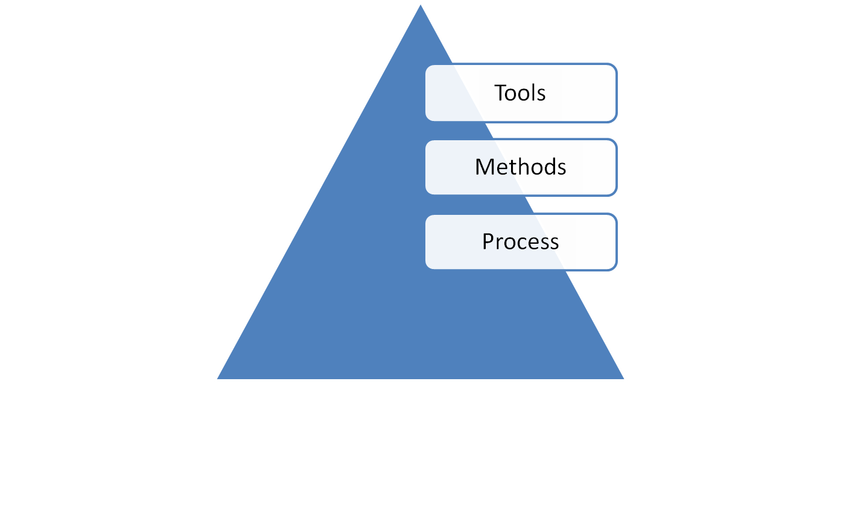
Software Engineering
Encompasses a process, methods and tools
Quality Focus

Slide 15
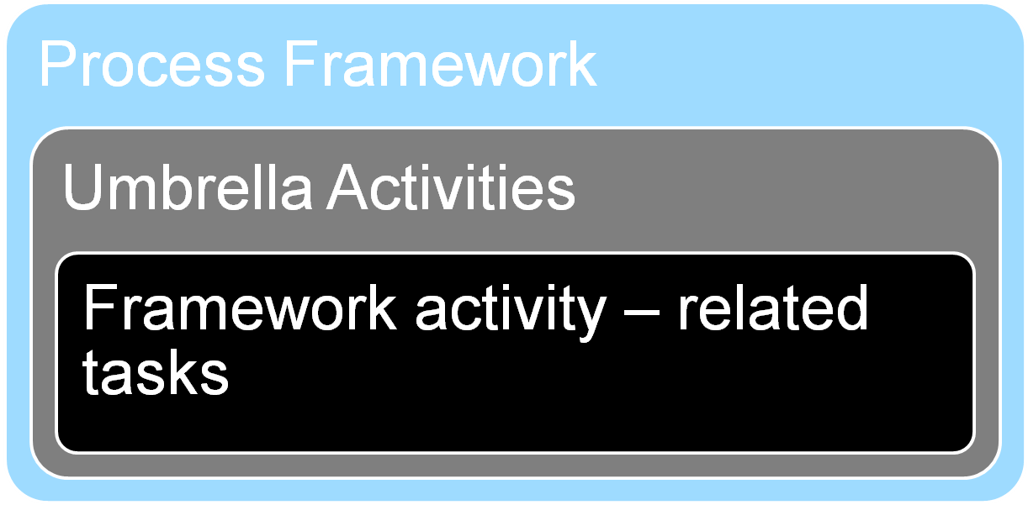
Software Engineering (Process Framework)
A process defines who is doing what, when and how to reach a certain goal – Jacobson, Booch, Rumbaugh

Slide 16
Software Engineering (Process Framework)
Generic Process Framework
  Communication – requirements gathering
  Planning
  Modeling / Prototyping
  Construction
  Deployment
The framework activities will remain the same across various projects, but the task within each activity will vary based on project requirement

Slide 17
Software Engineering (Process Framework)
Umbrella Activities
  Project tracking and control
  Risk management
  Quality assurance
  Technical reviews
  Measurement and Metrics
  Configuration Management
  Reusability management
  Documentation
  Product Preparation

Slide 18
Software Engineering (Sub-disciplines)
Software engineering can be divided sub –disciplines
  Software requirements
  Software Design
  Software development
  Software testing
  Software maintenance
  Software configuration management
  Software Project Management
  Software development process
  Software engineering tools
  Software quality
Notes:
Sub-disciplines
Software engineering can be divided into ten subdisciplines. They are:
Software requirements: The elicitation, analysis, specification, and validation of requirements for software.
Software design: The design of software is usually done with Computer-Aided Software Engineering (CASE) tools and use standards for the format, such as the Unified Modeling Language (UML).
Software development: The construction of software through the use of programming languages.
Software testing
Software maintenance: Software systems often have problems and need enhancements for a long time after they are first completed. This subfield deals with those problems.
Software configuration management: Since software systems are very complex, their configuration (such as versioning and source control) have to be managed in a standardized and structured method.
Software engineering management: The management of software systems borrows heavily from project management, but there are nuances encountered in software not seen in other management disciplines.
Software development process: The process of building software is hotly debated among practitioners with the main paradigms being agile or waterfall.

Slide 19
Q & A
Any Question?

Slide 20
Help ?
JAYANT Ponkshe
______________________________________
Reach me @ jayant.ponkshe@gmail.com

